Slide 1


Web application
Website designing make attractive

Slide 2

What is website
A website is a collection of web pages and related content that is identified by a common domain name and published on at least one web server. Websites are typically dedicated to a particular topic or purpose, such as news, education, commerce, entertainment or social networking.
A website is a collection of files accessed through a web address, covering a particular theme or subject, and managed by a particular person or organization. Its opening page is called a home page.

Slide 3
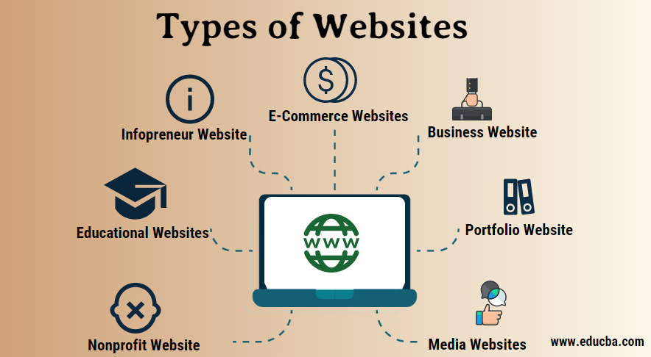
Types of website language
While there are many different programming languages, the most common ones used in web development are JavaScript, HTML, CSS, PHP, etc. JavaScript has a popularity of nearly 65% among developers worldwide, as per Statista.

Slide 4

What is Html
The Hypertext Markup Language or HTML is the standard markup language for documents designed to be displayed in a web browser. It defines the meaning and structure of web content. It is often assisted by technologies such as Cascading Style Sheets and scripting languages such as JavaScript.
HTML stands for Hyper Text Markup Language. HTML is the standard markup language for creating Web pages. HTML describes the structure of a Web page. HTML consists of a series of elements. HTML elements tell the browser how to display the content.

Slide 5
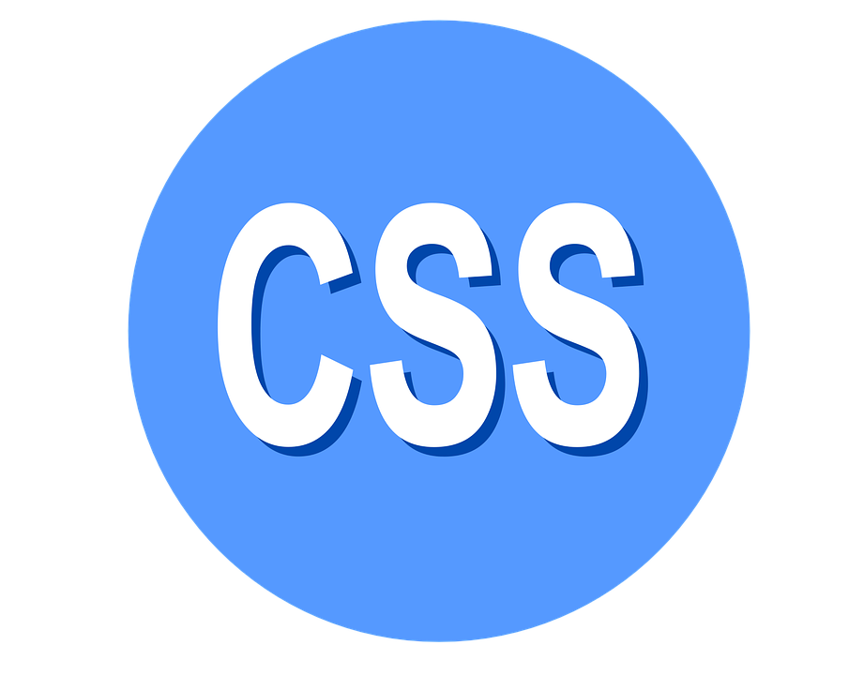
What is CSS & CSS++
CSS
CSS++
Cascading Style Sheets is a style sheet language used for describing the presentation of a document written in a markup language such as HTML or XML. CSS is a cornerstone technology of the World Wide Web, alongside HTML and JavaScript.
CSS is a computer language for laying out and structuring web pages (HTML or XML). This language contains coding elements and is composed of these “cascading style sheets” which are equally called CSS files
C++ is a high-level, general-purpose programming language created by Danish computer scientist Bjarne Stroustrup
CSS is a computer language for laying out and structuring web pages (HTML or XML). This language contains coding elements and is composed of these “cascading style sheets” which are equally called CSS files

Slide 6

What is mean by JavaScript
JavaScript is a scripting language that enables you to create dynamically updating content, control multimedia, animate images, and pretty much everything else. (Okay, not everything, but it is amazing what you can achieve with a few lines of JavaScript code.)
Developed in Netscape, JS allows developers to create a dynamic and interactive web page to interact with visitors and execute complex actions. It also enables users to load content into a document without reloading the entire page

Slide 7

What is PHP
PHP is a general-purpose scripting language geared towards web development. It was originally created by Danish-Canadian programmer Rasmus Leadoff in 1993 and released in 1995. The PHP reference implementation is now produced by the PHP Group
PHP code is usually processed on a web server by a PHP interpreter implemented as a module, a daemon or a Common Gateway Interface (CGI) executable. On a web server, the result of the interpreted and executed PHP code which may be any type of data, such as generated HTML or binary image data would form the whole or part of an HTTP response. Various web template systems, web content management systems, and web frameworks exist that can be employed to orchestrate or facilitate the generation of that response. Additionally, PHP can be used for many programming tasks outside the web context, such as standalone graphical applications and robotic drone control. PHP code can also be directly executed from the command line.
The standard PHP interpreter, powered by the Zend Engine, is free software released under the PHP License. PHP has been widely ported and can be deployed on most web servers on a variety of operating systems and platforms.

Slide 8
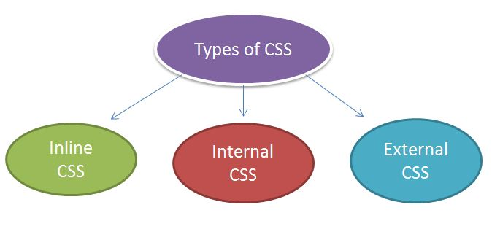
Types of CSS
Three types of CSS
There are three types of CSS which are given below:
Inline CSS.
Internal or Embedded CSS.
External CSS.

Slide 11
Thank you

